Slide 1
Open Data, Networks and the Law
Iain Carmichael and Michael Kim
PyData Carolinas 2016

Slide 2
Court opinions are legally binding for future cases
Stare Decisis means courts are bound by themselves and superior courts
courts should follow precedent
should not overturn precedent without good reason

Slide 3
important cases
community detection
open data
networks

Slide 4
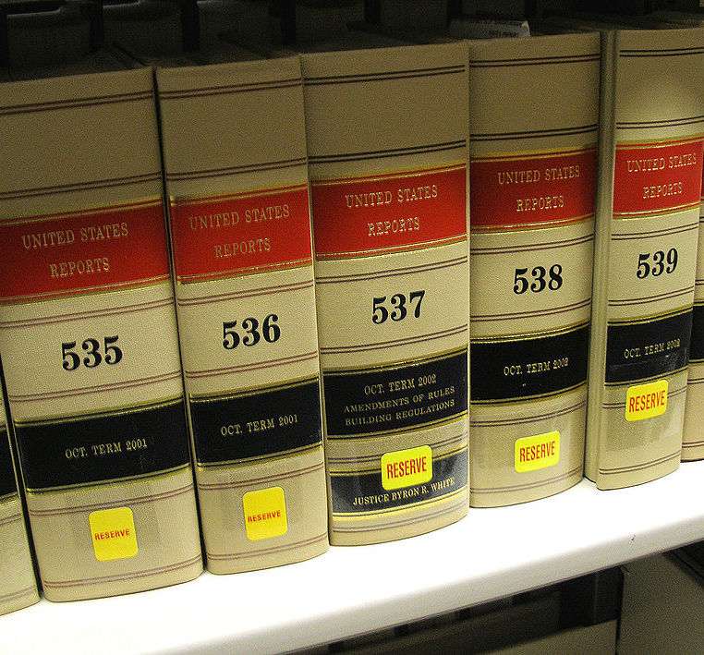
Judicial opinions are published in books called reporters
Notes:
Cite wikipedia for image

Slide 5
Most major digital sources of legal data are not free
LexisNexis, Bloomberg Law and WestLaw all cost money

Slide 6
Most major digital sources of legal data are not free
LexisNexis, Bloomberg Law and WestLaw all cost money
Large law firms pay for services

Slide 7
Most major digital sources of legal data are not free
LexisNexis, Bloomberg Law and WestLaw all cost money
Large law firms pay for services
Legal data is not owned by anyone

Slide 8

Free Law Project
501(c)(3) non-profit
to provide free, public, and permanent access to primary legal materials on the Internet for educational, charitable, and scientific purposes to the benefit of the general public and the public interest
@freelawproject
@mlissner

Slide 9
Court Listener
~ 3 million legal opinions
opinion text, citations, date, judges, etc

Slide 10
Court Listener
~ 3 million legal opinions
opinion text, citations, date, judges, etc
Judge database
judicial appointers, biographical data, political affiliations, etc

Slide 11
Court Listener
~ 3 million legal opinions
opinion text, citations, date, judges, etc
Judge database
judicial appointers, biographical data, political affiliations, etc
Oral arguments
800,000 minutes (and counting) of audio currently being transcribed by Google’s Speech to Text API

Slide 12
Other free, digital sources of legal data
Ravel
Justia
Oyez
Google Scholar
Legal Information Institute

Slide 13
Court Listener makes bulk download of large amounts of legal data easy
single click download of 3 million court opinions
30 GB of compressed data
includes citations

Slide 14
Court Listener offers a case recommendation system
CiteGeist is based on a keyword search and a measure relevancy determined by citations

Slide 15
important cases
community detection
open data
networks

Slide 16
What is a Network?
a network is a set of nodes
people in a social network
Iain
Abby
Sam
Dan

Slide 17
What is a Network?
a network is a set of nodes
people in a social network
and edges
Abby and Iain are FB friends
Iain
Abby
Sam
Dan

Slide 18
Kinds of Networks
Nodes can have have properties
name, text, physical location
Edges can be directed
links from one website to another
Edges can have weights
number of white-matter fibers connecting two regions of the brain

Slide 19


Social Networks: connections between people

Slide 20
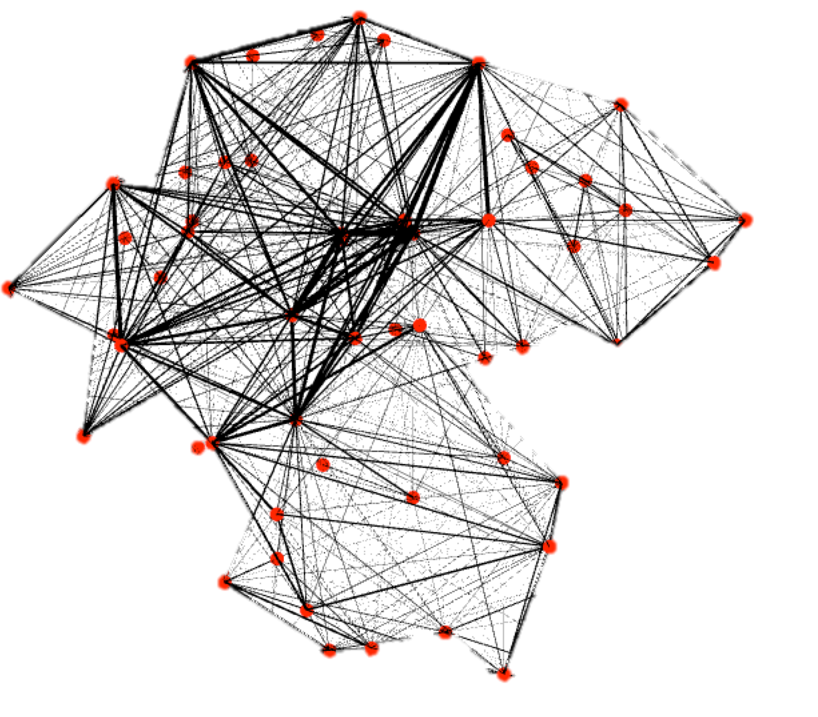
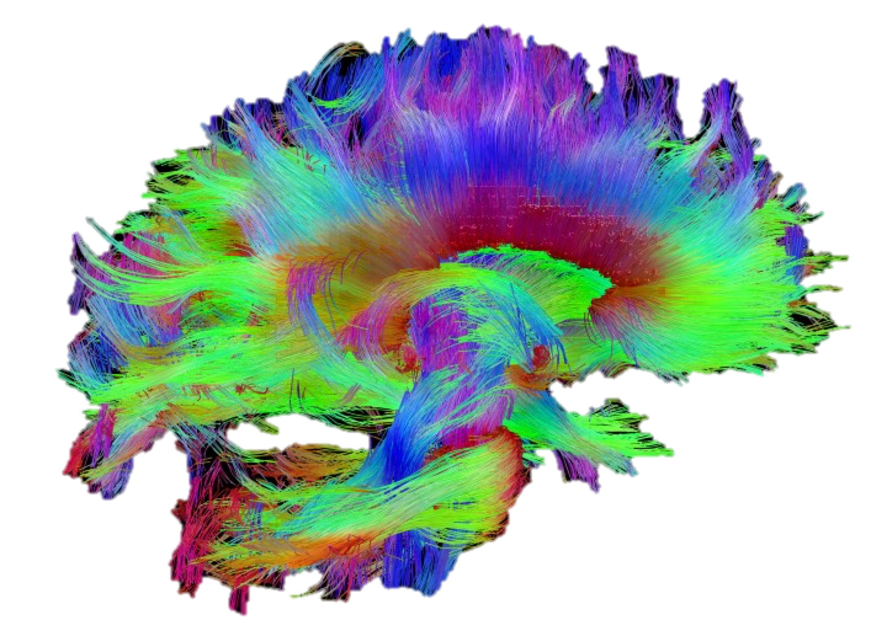
Brain Networks: white matter fiber tracts connecting different regions of the brain
Human Connectome Project, 2016
Neurodata.io, 2016

Slide 21
Legal case citation network
Brown v. Board
Nodes are court opinions
case text, date, judges, jurisdiction, political alignment
McLaurin
Sweatt
Sipuel
Shelley
Gains
McCabe
Notes:
https://www.courtlistener.com/visualizations/scotus-mapper/966/mccabe-1914-to-brown-1954/

Slide 22
Legal case citation network
Brown v. Board
Nodes are court opinions
case text, date, judges, jurisdiction, political alignment
Edges are directed, no cycles
~3 million cases
~30 million citations
McLaurin
Sweatt
Sipuel
Shelley
Gains
McCabe
Notes:
https://www.courtlistener.com/visualizations/scotus-mapper/966/mccabe-1914-to-brown-1954/

Slide 23
SCOTUS sub-network
Focus on only cases in the Supreme Court of the United States
30,000 cases
250,000 citations between SCOTUS cases

Slide 24
We used two graph packages
NetworkX
written in Python
good documentation
iGraph
written in C, wrapped in Python and R
poor documentation in python

Slide 25
What can networks tell us about the law?
What are the most important cases?
what does important mean?
How does legal precedent evolve?
Can we build an even better case recommendation system?

Slide 26
important cases
community detection
open data
networks
in-degree
closeness centrality
PageRank
Others

Slide 27
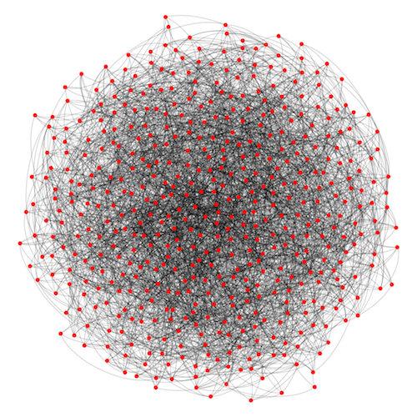
Visualizing large networks is hard
physics based heuristic layout
approximates the equilibrium state of a certain physical system made of springs
aims to minimize edge crossings
make edge lengths as uniform
other heuristic layouts did not do any better

Slide 28
In-degree and closeness centrality

Slide 29
Vertex in-degree
in-degree = how many times were you cited

Slide 30
Closeness centrality is based on a notion of distance between nodes in a graph

Slide 31
Shortest path between two nodes is a reasonable measure of distance between nodes
Iain
Abby
Sam
Dan

Slide 32
Shortest path between two nodes is a reasonable measure of distance between nodes
Iain
Abby
d(Sam, Abby) = 2
Sam
Dan

Slide 33
In a directed graph you can only travel along the direction of the edge
Iain
Iain
Abby
Abby
Sam
Sam
Dan
Dan

Slide 34
In a directed graph you can only travel along the direction of the edge
Sam can walk to Dan
Dan can not walk to Sam
A case in 2000 can cite a case in 1900
A case in 1900 can not cite a case in 2000
Iain
Iain
Abby
Abby
Sam
Sam
Dan
Dan

Slide 35
Closeness Centrality measures how “close” a vertex is to all other vertices in the graph

Slide 36
Closeness Centrality measures how “close” a vertex is to all other vertices in the graph
if d(V, c) is small for most cases c then closeness(v) is large

Slide 37
Closeness Centrality measures how “close” a vertex is to all other vertices in the graph
if d(V, c) is small for most cases c then closeness(v) is large
have to compute all pairs shortest paths which is slow in a large network
cubic in the number of nodes

Slide 38
NetworkX can be on large networks
NetworkX
iGraph
7 hours for all pairs shortest paths
5 minutes for all pairs shortest paths

Slide 39
Who is the most important node?
A
B

Slide 40
Degree centrality says B is the most important case
A
B

Slide 41
Closeness centrality says A is the most important case
A
B

Slide 42
Closeness centrality says A is the most important case
A connects two separate clusters of nodes
A
B

Slide 43
SCOTUS cases ranked by in-degree

Slide 44
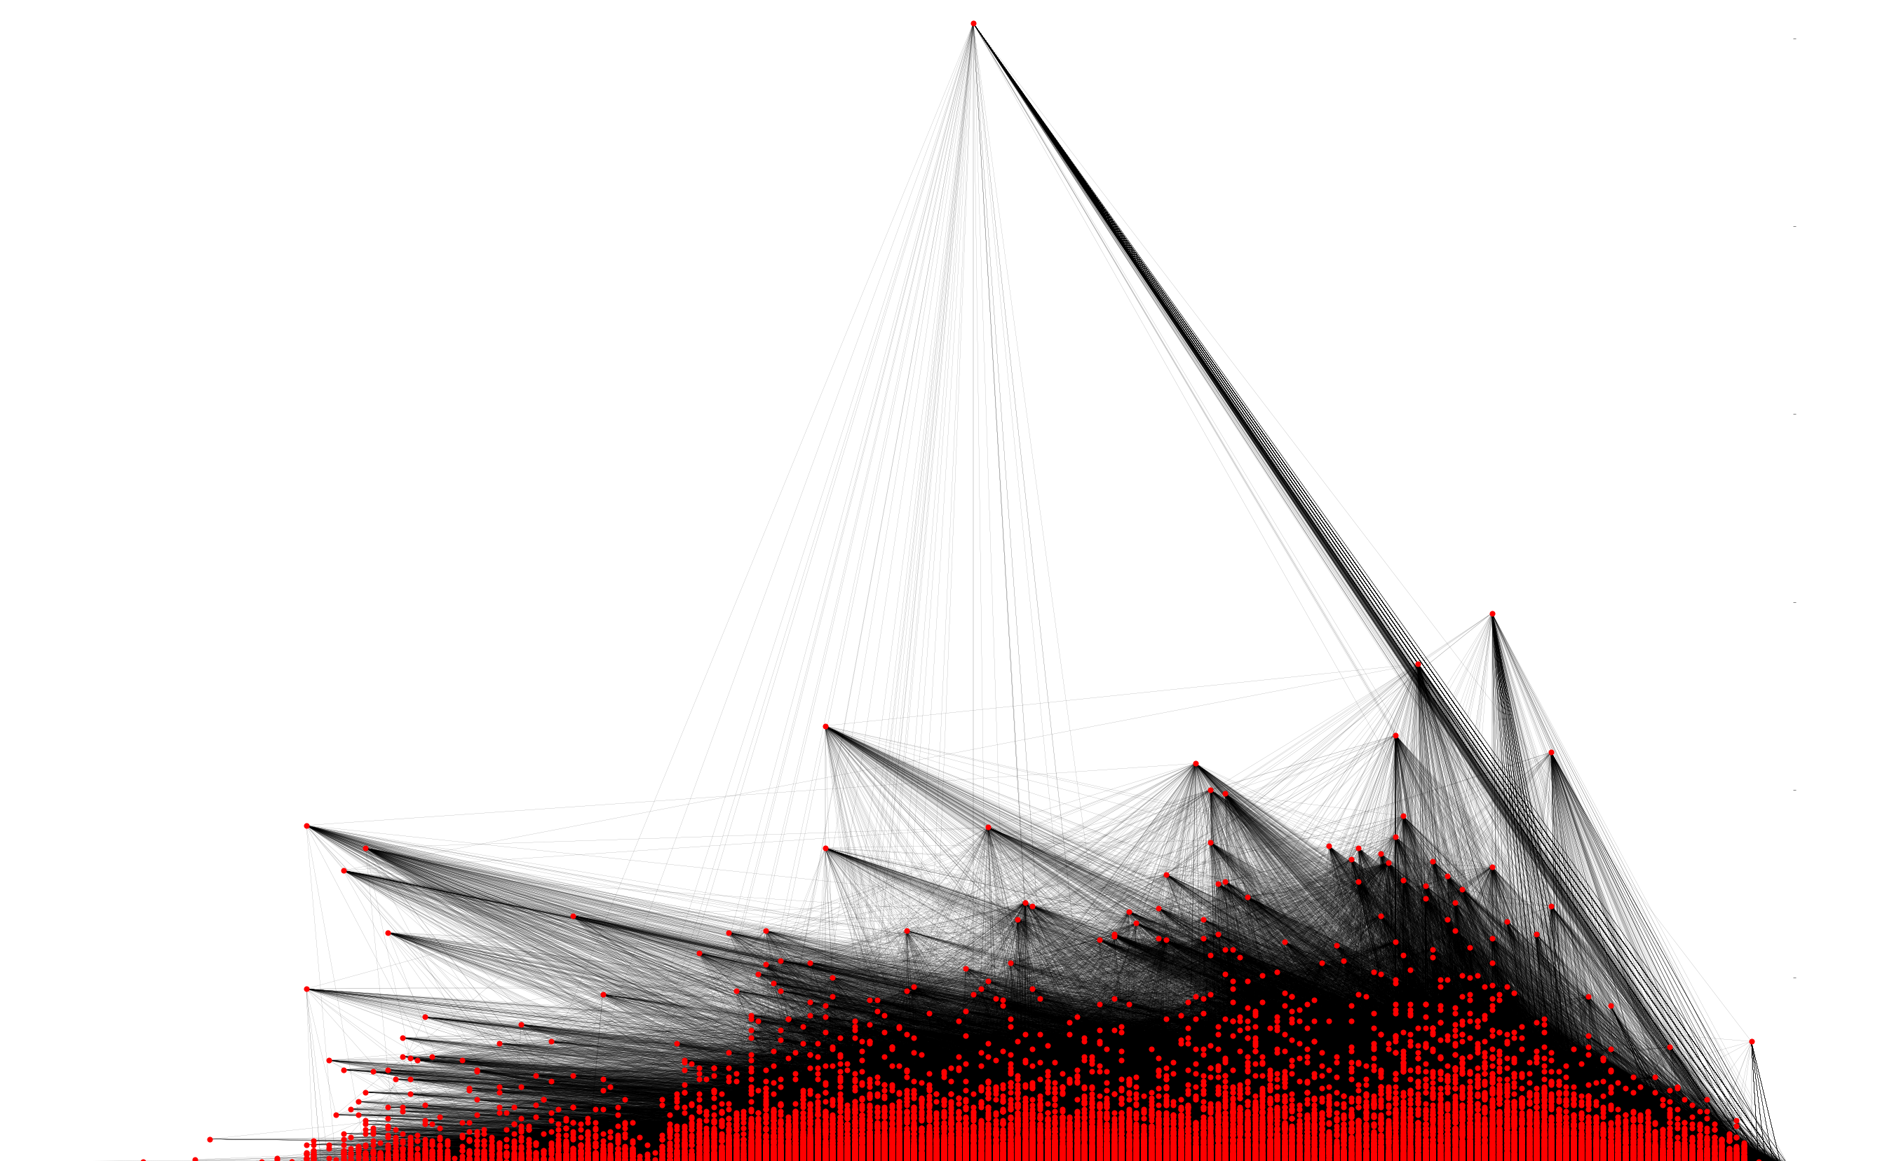
Network metadata can help make useful large network visualizations

Slide 45
Network metadata can help make useful large network visualizations
600
In-degree
300
100
Date
1900
2000

Slide 46
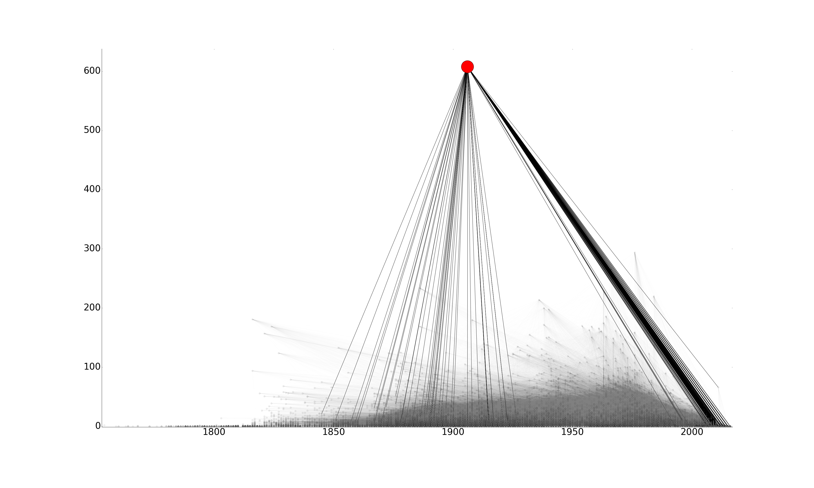
One case immediately stands out in the in-degree plot
US v. Detroit Timber and Lumber Company
~600 citations, all fairly recent
twice as many citations as every other case
600
In-degree
300
100
1900
2000

Slide 47
US v. Detroit is not an important case
Law reporters (the books) sometimes include cliff notes about cases

Slide 48
US v. Detroit is not an important case
Law reporters (the books) sometimes include cliff notes about cases
Lawyers started citing the commentary as law

Slide 49
US v. Detroit is not an important case
Law reporters (the books) sometimes include cliff notes about cases
Lawyers started citing the commentary as law
Supreme court recently ruled against this practice

Slide 50
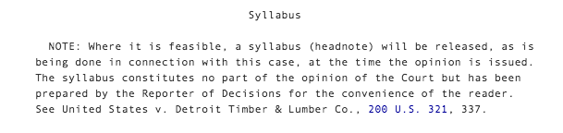
Reporters now include a warning that cites the Detroit case

Slide 51
SCOTUS cases ranked by Closeness Centrality

Slide 52
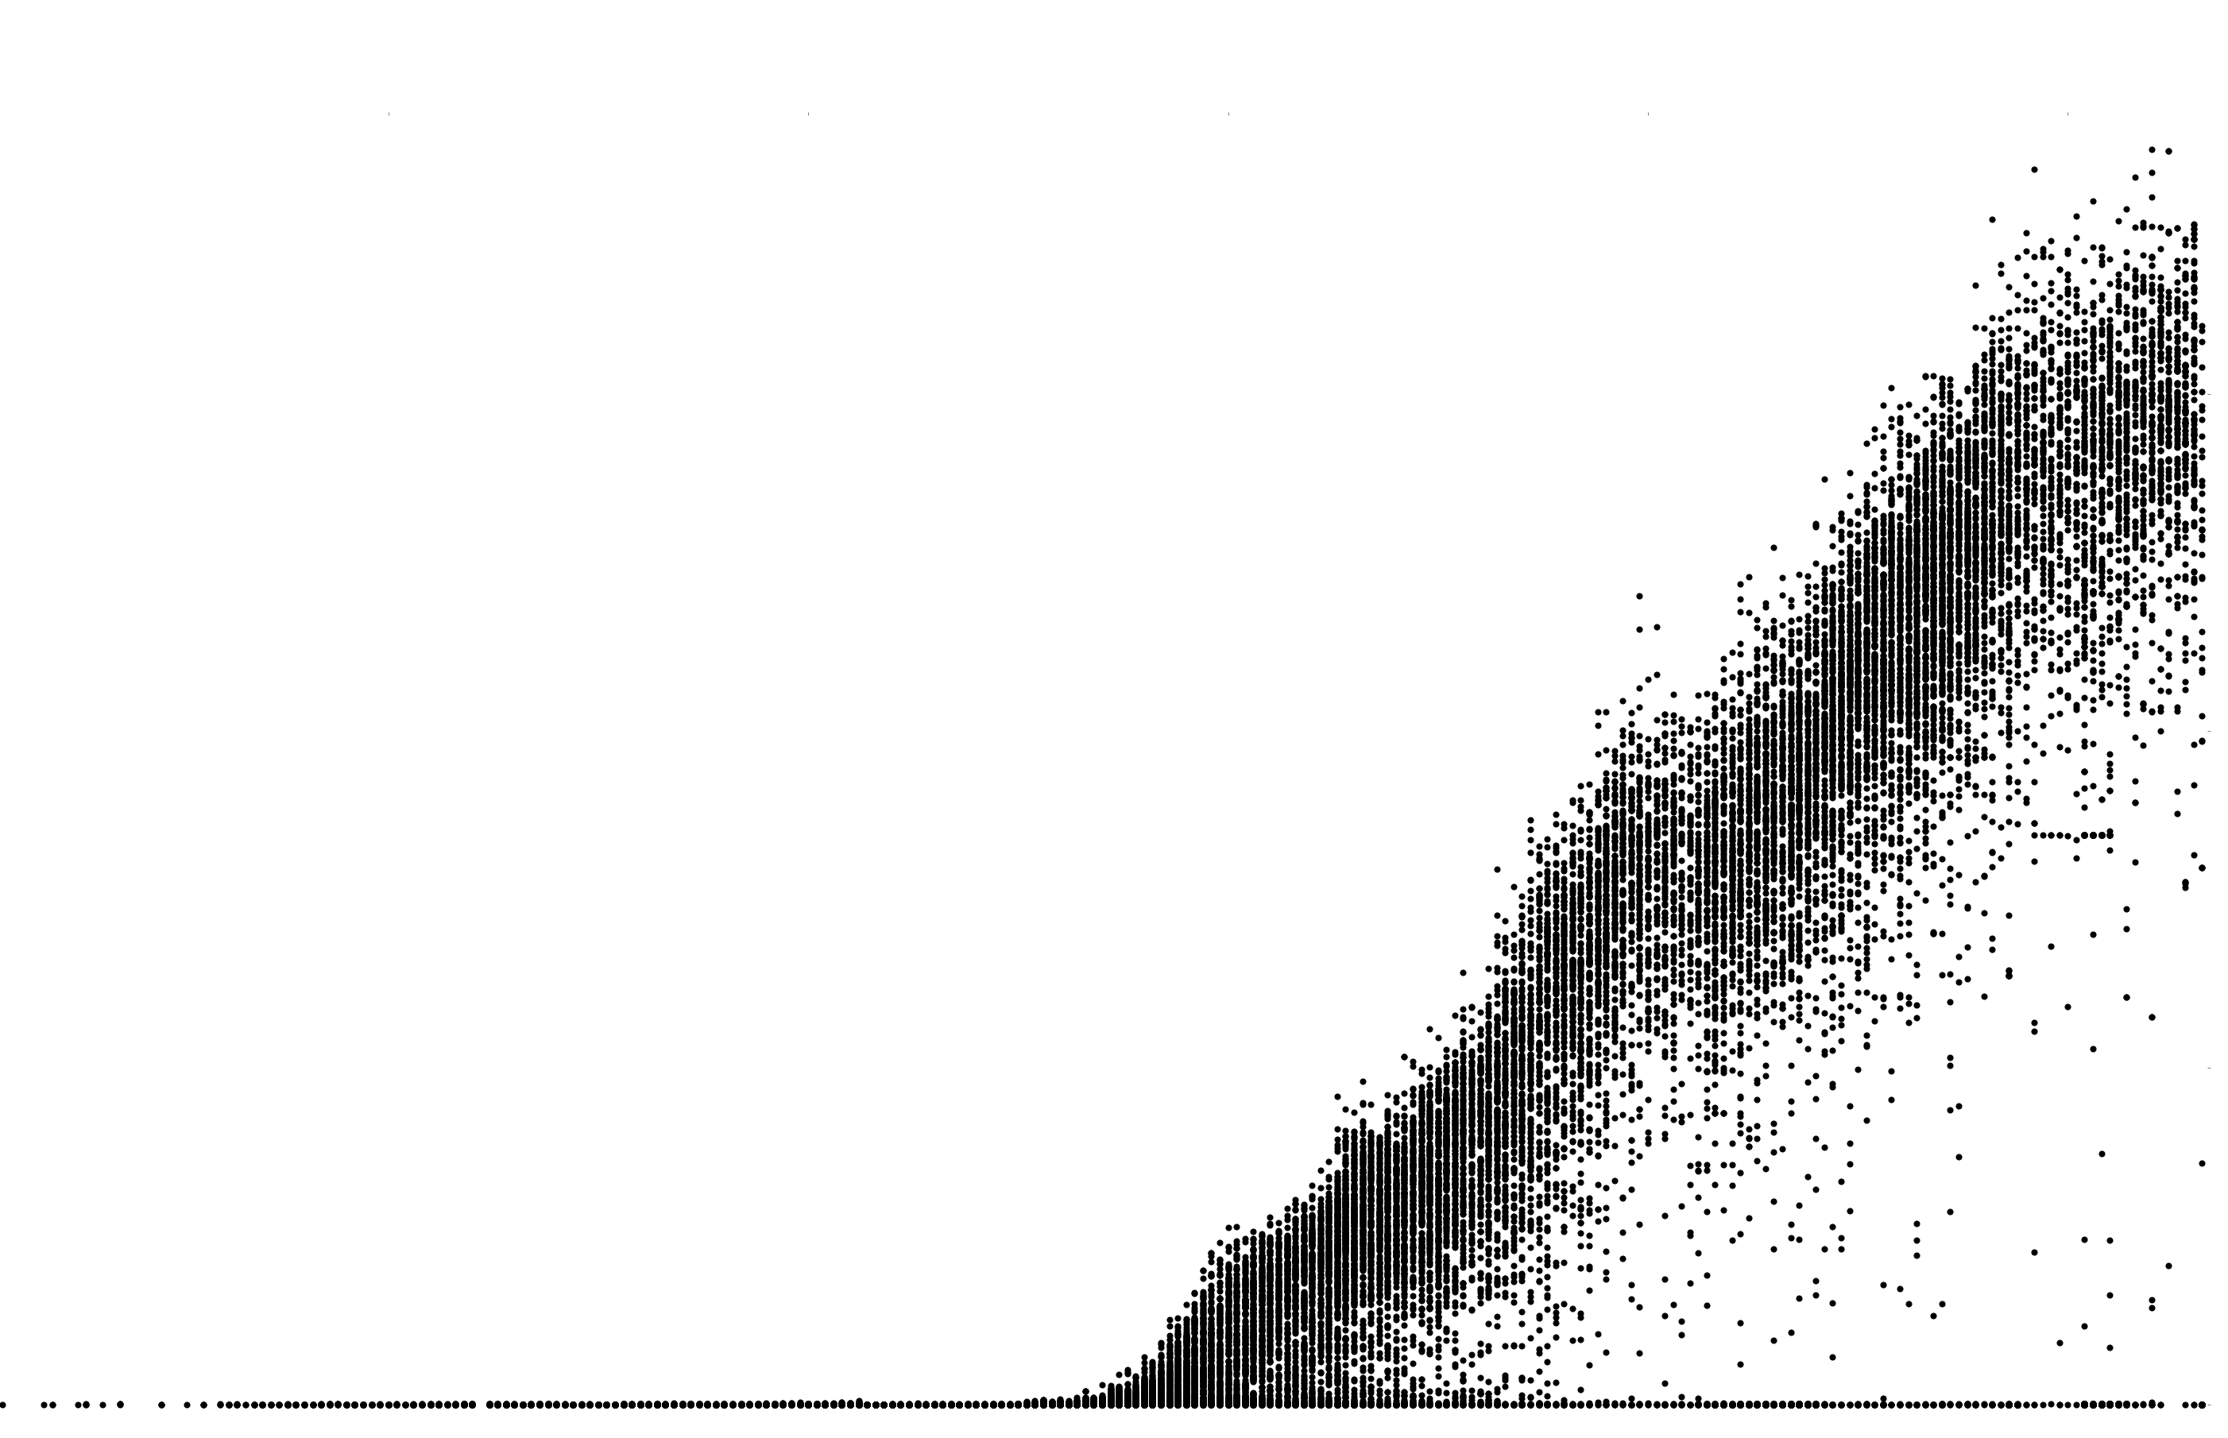
Closeness centrality of the directed graph is strongly correlated with date
Closeness Centrality
Date
1900
2000

Slide 53
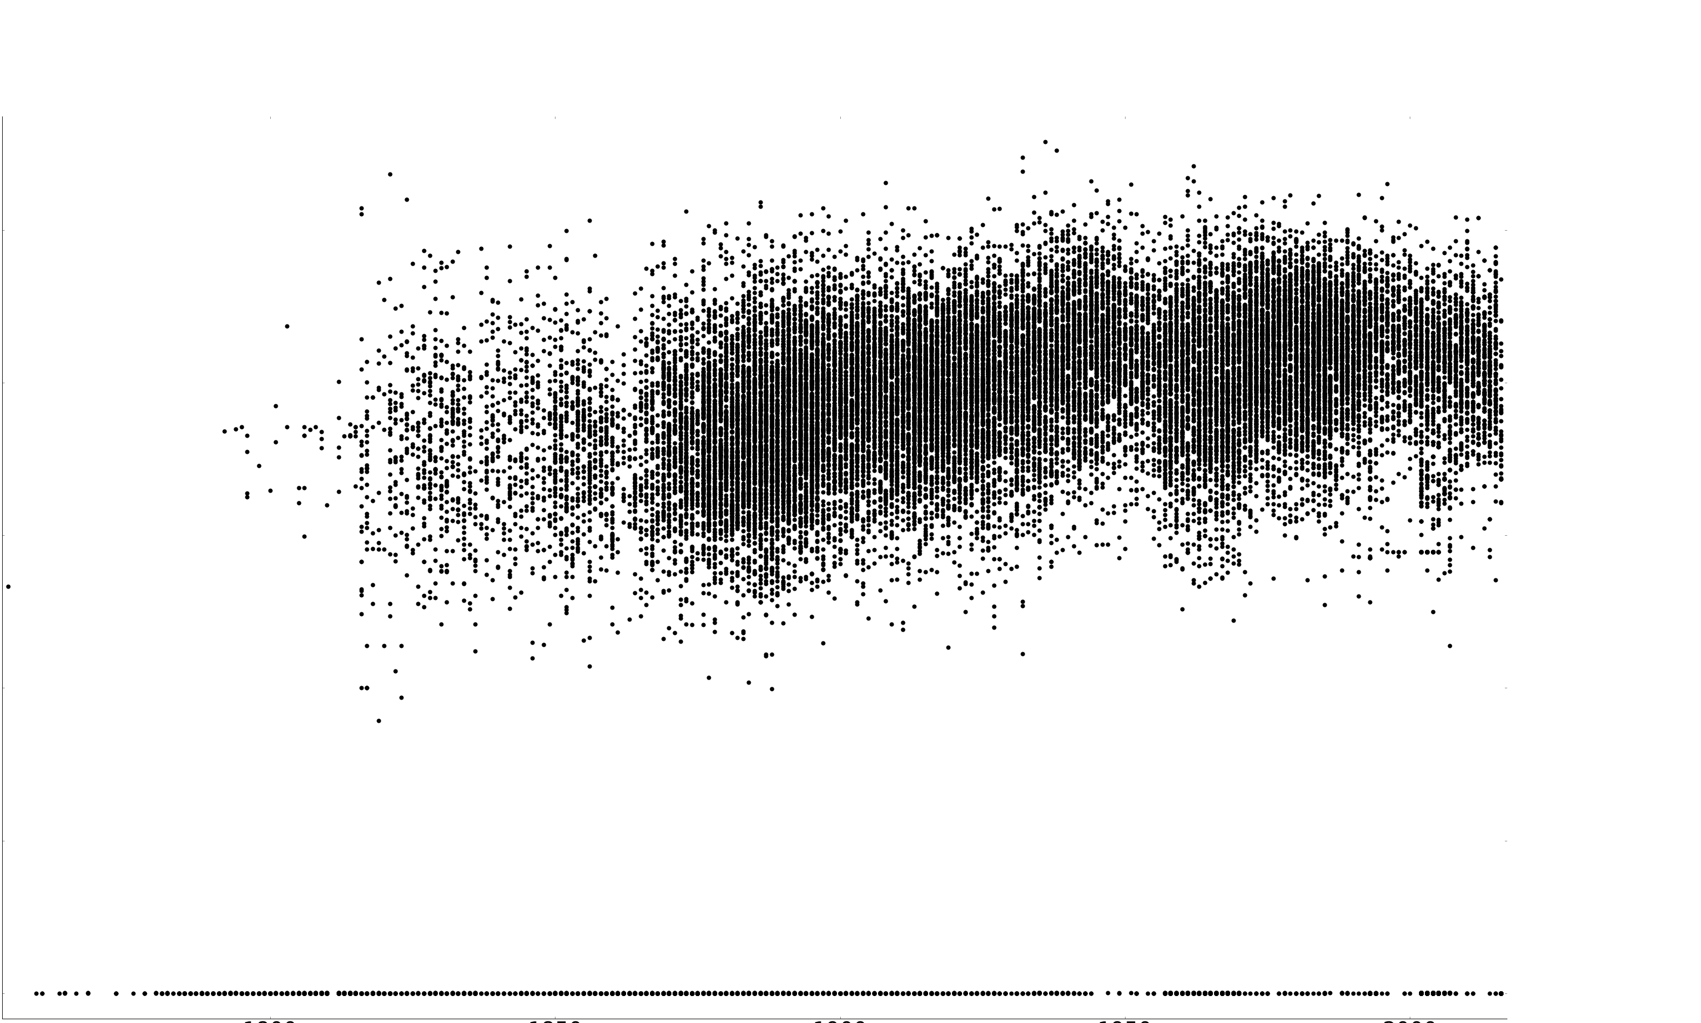
Closeness Centrality on the undirected graph is more meaningful
Closeness Centrality
Date
1900
2000

Slide 54
Closeness Centrality on the undirected graph favors procedural cases
Top SCOTUS cases by closeness centrality
1. Ashwander v. TVA (1936): Constitutional Avoidance
2. Erie RR v. Tompkins (1938): Federal courts must apply state law
3. Crowell v. Benson (1932): Adjudication by administrative agencies
4. Baker v. Carr (1962): Voting rights, redistricting is judiciable
5. Burnet v. Coronado Oil and Gas (1932): Stare Decisis, cited in Erie
6. Cohens v. Virginia (1821): SCOTUS review of criminal trials w/constitutional question
7. Monroe v. Pape (1961): 1983 can be used to sue state officers
8. Glidden Co. v. Zdanok (1962): Courts of Claims and Patent appeal = Article 3
9. Yakus v US (1944): Admin law, delegation
10.Ex Parte Young (1908): Allows suits against state officials

Slide 55
Procedural cases connect disparate areas of law
procedural law is about how the courts operate
can be some of the most important cases
two cases about unrelated topics may cite a procedural case

Slide 56
Closeness Centrality on the undirected graph favors procedural cases
Erie Rail Road v. Tompkins is about what body of law federal courts may rely on
Top SCOTUS cases by closeness centrality
1. Ashwander v. TVA (1936): Constitutional Avoidance
2. Erie RR v. Tompkins (1938): Federal courts must apply state law
3. Crowell v. Benson (1932): Adjudication by administrative agencies
4. Baker v. Carr (1962): Voting rights, redistricting is judiciable
5. Burnet v. Coronado Oil and Gas (1932): Stare Decisis, cited in Erie
6. Cohens v. Virginia (1821): SCOTUS review of criminal trials w/constitutional question
7. Monroe v. Pape (1961): 1983 can be used to sue state officers
8. Glidden Co. v. Zdanok (1962): Courts of Claims and Patent appeal = Article 3
9. Yakus v US (1944): Admin law, delegation
10.Ex Parte Young (1908): Allows suits against state officials

Slide 57
Closeness Centrality picked cases that connected disparate clusters of cases
A connects two separate clusters of nodes
A
B

Slide 58
PageRank

Slide 59
PageRank ranks vertices in a directed network
a case is important if
it is cited frequently and
by other important cases
PageRank is at the heart of Google’s search algorithm
Page is a play on web page and Larry Page
Notes:
Cite Murphy

Slide 60
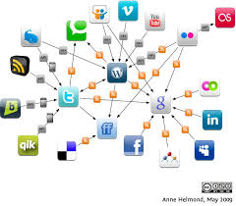
PageRank was designed for the network of websites
Nodes are websites
Directed edges are hyperlinks from one page to another
There can be loops

Slide 61
Imagine randomly surfing the web for a long time
go to a new website by randomly clicking a link from the current website
Iain’s website
NY Times
Facebook
HuffPo

Slide 62
Imagine randomly surfing the web for a long time
go to a new website by randomly clicking a link from the current website
occasionally pick a website completely at random
could be one that is not necessarily linked to the
current page
Iain’s website
NY Times
Facebook
HuffPo

Slide 63
How long did you spend on Facebook?
the proportion of the time you spend on a website is its PageRank value

Slide 64
How long did you spend on Facebook?
the proportion of the time you spend on a website is its PageRank value
it is the stationary distribution of this random walk
can be computed efficiently

Slide 65
SCOTUS cases ranked by PageRank

Slide 66
PageRank tends to pick out older cases that precede landmark cases
Top SCOTUS cases by PageRank
1. Boyd v. US (1886): Compulsion of Documents = 4th amendment violation
2. Brown v. Maryland (1827): Commerce clause, international trade
3. Slaughter House Cases (1873): 14th amendment beginnings
4. Martin v. Hunter’s Lessee (1816): SCOTUS can review state supreme courts
5. Davidson v. New Orleans (1877): 14th amendment beginnings
6. Weeks v. United States (1914): Fourth amendment seizures, exclusion of evidence
7. Ex Parte Lange (1874): Double jeopardy
8. Cohens v. Virginia (1821): SCOTUS review of criminal trials w/constitutional question
9. Murray's Lessee v. Hoboken Land & Improvement (1856): Due process and debt

Slide 67
PageRank tends to pick out older cases that precede landmark cases
first cases about the 14th Amendment
slightly expanded the interpretation
Top SCOTUS cases by PageRank
1. Boyd v. US (1886): Compulsion of Documents = 4th amendment violation
2. Brown v. Maryland (1827): Commerce clause, international trade
3. Slaughter House Cases (1873): 14th amendment beginnings
4. Martin v. Hunter’s Lessee (1816): SCOTUS can review state supreme courts
5. Davidson v. New Orleans (1877): 14th amendment beginnings
6. Weeks v. United States (1914): Fourth amendment seizures, exclusion of evidence
7. Ex Parte Lange (1874): Double jeopardy
8. Cohens v. Virginia (1821): SCOTUS review of criminal trials w/constitutional question
9. Murray's Lessee v. Hoboken Land & Improvement (1856): Due process and debt

Slide 68
PageRank tends to pick out older cases that precede important cases
first cases about the 14th Amendment
began expanding the interpretation
not important by itself
led to the Civil Rights Act and legalization of gay marriage
Top SCOTUS cases by PageRank
1. Boyd v. US (1886): Compulsion of Documents = 4th amendment violation
2. Brown v. Maryland (1827): Commerce clause, international trade
3. Slaughter House Cases (1873): 14th amendment beginnings
4. Martin v. Hunter’s Lessee (1816): SCOTUS can review state supreme courts
5. Davidson v. New Orleans (1877): 14th amendment beginnings
6. Weeks v. United States (1914): Fourth amendment seizures, exclusion of evidence
7. Ex Parte Lange (1874): Double jeopardy
8. Cohens v. Virginia (1821): SCOTUS review of criminal trials w/constitutional question
9. Murray's Lessee v. Hoboken Land & Improvement (1856): Due process and debt

Slide 69
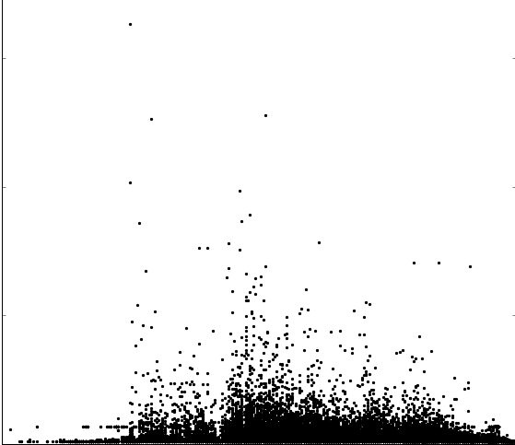
PageRank favors older cases
PageRank
1800
Date
1900
2000

Slide 70
Erie RR is ranked 94thby PageRank
PageRank
1800
Date
1900
2000

Slide 71
Detroit Lumber is ranked 65th by PageRank
PageRank
1800
Date
1900
2000

Slide 72
Why PageRank favors older cases

Slide 73
PageRank in a DAG
in a direct, acyclic graph the random surfer will usually go backwards in time
the random walk prefers to hang out in older cases
2015
2010
2005
2000

Slide 74
PageRank in a DAG
in a direct, acyclic graph the random surfer will usually go backwards in time
the random walk prefers to hang out in older cases
2015
2010
2005
2000

Slide 75
Other measures of vertex importance

Slide 76
Betweenness centrality is similar to closeness centrality
seeks cases that tend to lie “between” other cases
also favored procedural cases

Slide 77
Hubs/authorities and eigenvector centrality picked similar cases
a case is important if it is cited
a lot
by other important cases
both favor substantive cases
First Amendment law
Authority scores match well with legal expert opinion (Fowler et all, 2008)

Slide 78
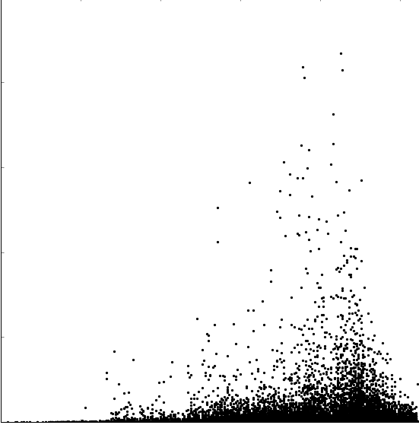
Authority scores are a promising metric
Authority Score
1800
Date
1900
2000

Slide 79
Authority did not identify Detroit Lumber as a top 10 case
Authority Score
1800
Date
1900
2000

Slide 80
Authority scores favor cases from the middle of the 20th century
Authority Score
1800
Date
1900
2000

Slide 81
Every dog has its day
there is not a best measure of case importance
different measures favor different latent qualities

Slide 82
Improvements to case recommendation system
use other notions of vertex importance
authorities score
implement multiple recommendation systems
procedural vs. substantive
include time decay term for case quality

Slide 83
Community Detection

Slide 84
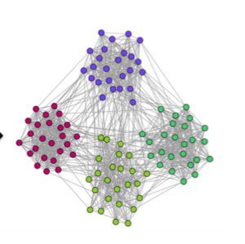
Community detection clusters the nodes in a network
A community is a group of nodes that are densely connected to each other, but sparsely connected with the rest of the graph
Stanley 2016

Slide 85
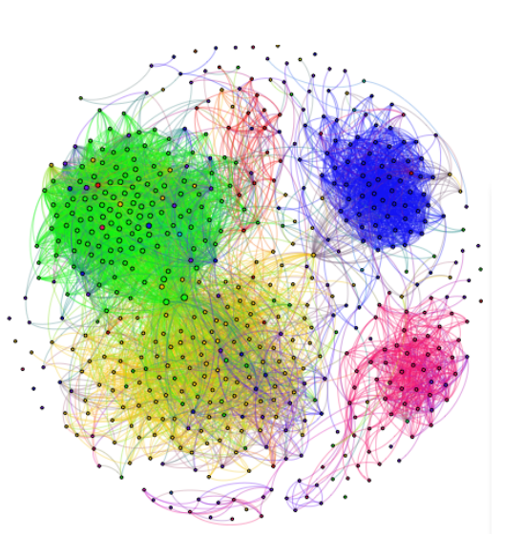
Community Detection applied James’ Facebook network discovered his college friends and high school friends
Extraction of Statistically Significant Communities
discovered 7 communities
Nobel, 2016
Wilson, 2013

Slide 86
Community detection is unsupervised learning
Optimization
Spectral Clustering (Ng et al, 2002)
Min-cut (Goldberg et al, 1998)
MLE or posterior inference
Stochastic Block Model (Snijders, 1997)
Statistical significance
ESSC (Wilson et al, 2014)
Modularity (Newman et al, 2004)
Random Walk
Walktrap (Pons et al)
Hierarchical clustering
Edge Betweenness (Newman et al, 2002)

Slide 87
There are several communities we might expect to find in the legal citation network
Court jurisdictions
SCOTUS, NC court of appeals, etc
Geography
North East
Areas of the law

Slide 88
Summary

Slide 89
Major points
Open legal data is important because court opinions are law
Different notions of vertex importance get at different latent qualities
PageRank favors older cases in a citation network

Slide 90
Future Work

Slide 91
Fit probabilistic models for network growth
Preferential attachment
Preferential attachment with aging
PA using other measures of vertex importance
Include covariates
opinion text, judge, jurisdiction, date

Slide 92
Use the text data of the opinions and the citation network
Compare text based opinion clustering with network based opinion clustering
Topic modeling
Use both text and citation information to infer communities

Slide 93
Contributors
Brendan Schneiderman
Iain Carmichael
James Jushchuk
James Wudel
Michael Kim
Shankar Bhamidi
https://github.com/idc9/law-net

Slide 94
References
Goldberg, Andrew V., and Kostas Tsioutsiouliklis. "Cut Tree Algorithms: An Experimental Study." Journal of Algorithms 38.1 (2001): 51-83. Web.
Kolaczyk, Eric D. Statistical Analysis of Network Data: Methods and Models. New York: Springer, 2009. Print.
Murphy, Kevin P. Machine Learning: A Probabilistic Perspective. Cambridge, MA: MIT, 2012. Print.
Newman, M. E. J., and M. Girvan. "Finding and Evaluating Community Structure in Networks." Physical Review E Phys. Rev. E 69.2 (2004): n. pag. Web.
Newman, M.E.J., and M. Girvan. "Community Structure in Social and Biological Networks." Proc. Natl. Acad. Sci. 99.12 (2002): 7821-826. Web.
Ng, Andrew Y., Michael Jordan I., and Yair Weiss. "On Spectral Clustering: Analysis and an Algorithm." NIPS Conference (2002): n. pag. Web.
Pons, Pascal, and Matthieu Latapy. "Computing Communities in Large Networks Using Random Walks." Computer and Information Sciences - ISCIS 2005 Lecture Notes in Computer Science (2005): 284-93. Web.
Snijders, Tom A.b., and Krzysztof Nowicki. "Estimation and Prediction for Stochastic Blockmodels for Graphs with Latent Block Structure." Journal of Classification 14.1 (1997): 75-100. Web.
Wilson, James D., Simi Wang, Peter Mucha J., Shankar Bhamidi, and Andrew Nobel B. "A Testing Based Extraction Algorithm for Identifying Significant Communities in Networks." The Annals of Applied Statistics 8.3 (2014): 1853-891. Web.

Slide 95
References
Human Connectome Project. http://www.humanconnectomeproject.org/, n.d. Web. 10 Sept. 2016.
Neurodata. http://neurodata.io/, n.d. Web. 10 Sept. 2016. Lecture.
Stanley, Natalie. “Communities in Networks” 14 Feb 2016
Nobel, Andrew. “Community Detection” 10 Sept 2016, STOR 767: Advanced Machine Learning. Lecture.

